Slide 1
Investigating geothermal heat resources of legacy mine workings, why are some mine waters hotter than others?
Mylene Receveur
Christopher McDermott, Stuart Gilfillan, Andrew Fraser-Harris

Slide 2
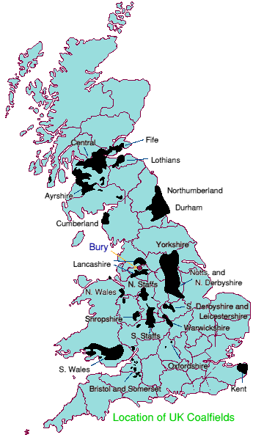
Study background
Introduction
Methods
Objectives
Conclusion
Summary
9% of UK population located above abandonned coal mines
Heat demand = >1/3 of energy consumption in the UK
Low-temperature geothermal resource (T= 12-20 °C)
7% of Scotland’s heat demand (Todd et al., 2019)
Can contribute to decarbonization of residential heat

Slide 3
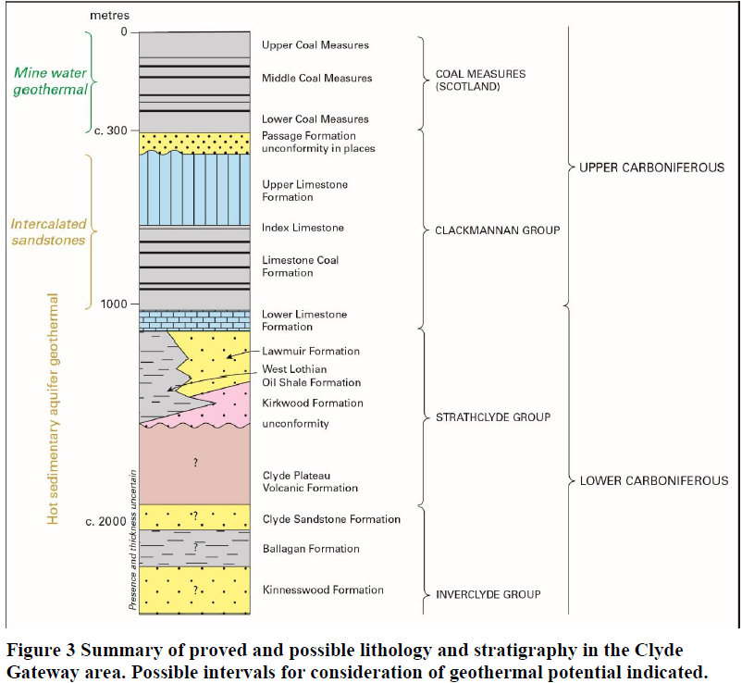
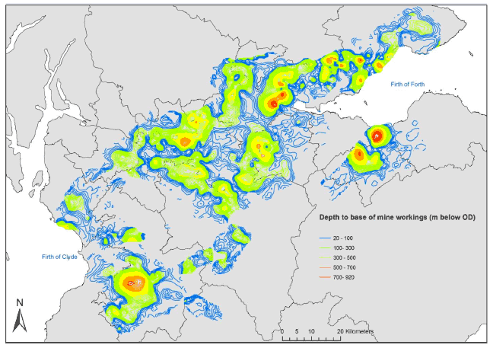
Mine-water Heat: Resource definition
Introduction
Methods
Objectives
Conclusion
Summary
Coal Measures
Limestone Coal formation
Depth of mine workings (Gillespie et al., 2013)

Slide 4
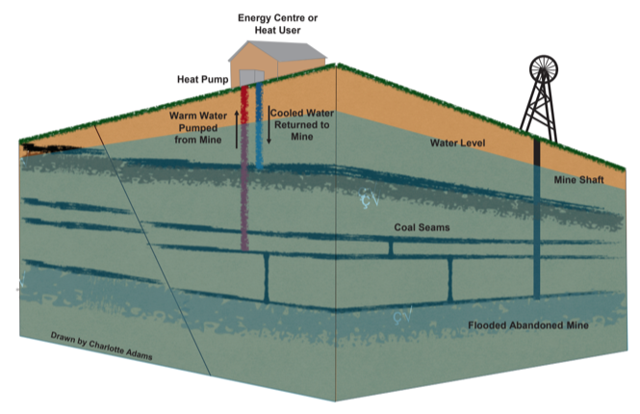
Mine-water Heat: Resource definition
Introduction
Methods
Objectives
Conclusion
Summary
Mine gets flooded when mining stops
Large voids = large water volume
Open-loop GSHP systems.
Cyclical / seasonal production
Existing case study: UK (Shettleston, Dawdon), Spain, Canada, USA, Poland, The Netherlands (Heerlen)
Coal Authority liability to UK mines and interests
Schematic Diagram of a mine water heat pump system (Charlotte Adams)
Notes:
Mine gets flooded when mining stops
Warm water can be extracted at high rates from enhanced-permeability reservoirs
GSHP used to extract heat from the ground or from the water using open-loop systems.
Injection/production of cold/hot water can be reversed seasonally
Existing case study: Germany, Canada, USA, UK (Shettleston, Dawdon, Markham), Poland, The Netherlands, Spain
At Heerlen, abandoned mines are used to deliver space heating and cooling to around 200,000 m2 of mixed use new and retrofit buildings via a 7-km-long heat network (Verhoeven et al., Energy Procedia 2014).
Two permanent open loop mine water-based ground source heating schemes commissioned in 1999-2000 in Shettleston (used to heat to 16 dwellings over an area of 1600 m² near Glasgow) and in Lumphinnans, near Cowdenbeath in Fife (Banks et al., 2009). There, 12°C and 14.5°C water is pumped at a rate of 5-10 l/s from about 100 and 172 m, respectively. The water circulates through the heat pump before being reinjected at a temperature of 3°C in the Carboniferous strata, via 50 and 60 m deep boreholes located 20 and 100 m away from the production ones (Banks et al., 2004). The table below summarizes the mine-water projects listed in the UK.
In Shettleston, where at least 6 seams have been mined, the water is heated to 55°C through a heat exchanger, to provide heat to 16 dwellings. In Lumphinnans, at least 11 seams belonging to the Lower Carboniferous Limestone Coal Group have been mined (including the uppermost Lochgelly Black Band Ironstone, the Seven Foot Seam, the Kelty Main, the Jersey or Diamond Seam and the Swallowdrum (Burke 1999)).

Slide 5
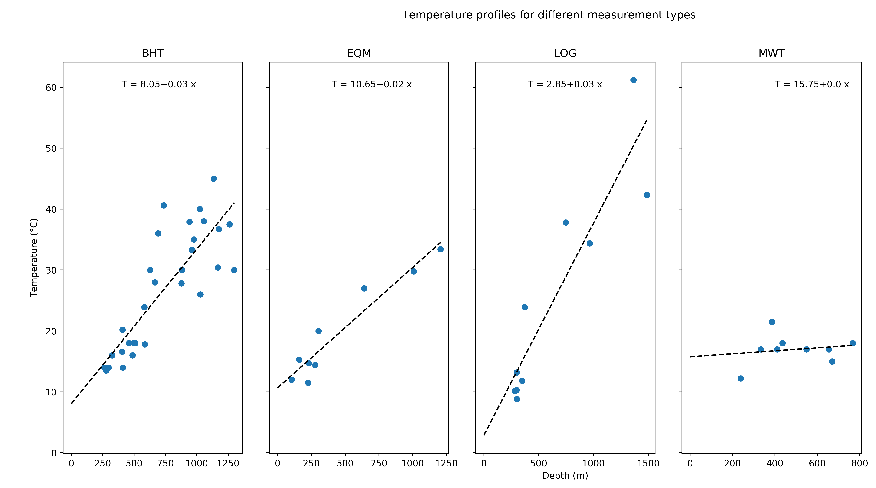
Research question
Introduction
Methods
Objectives
Conclusion
Summary
?????????????????
What are the main control on mine water temperature ?
Necessary to evaluate the geothermal potential of coal mines.
Notes:
Poor understanding of the origin of heat in mines: issue to evaluate the geothermal potential
No clear correlation of temperature with depth (Gillespie et al., 2013)
Extracting water can induce inflow of recharge water (from infiltration, lateral aquifers), or re-injection can be performed.
Need to know what are the heat recharge mechanisms, the rate heat recovery and the area impacted by heat extraction, to ensure sustainable production

Slide 6
Summary
Introduction
Methods
Objectives
Conclusion
Summary
Research objectives
Methods
Literature review
Suggested methodology
Conclusion
Expected results

Slide 7
Introduction
Methods
Objectives
Conclusion
Summary
Determine the main heat sources and heat transfer mechanisms in flooded coal mines
What is the heat recovery rate of water in coal mines?
Assess the important geometrical features in mine plans.
How can representative simplification of mine plans be made?
Evaluate the footprint area of heat extraction
What is the geothermal potential of mines?
Can a sustainable heat extraction rate be maintained?

Slide 8
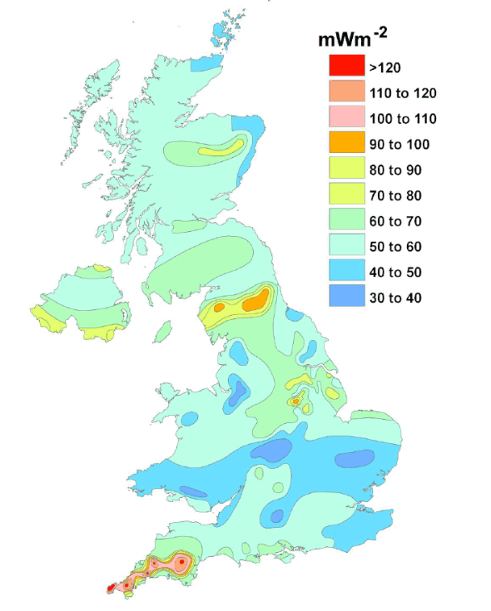
Objective 1
Introduction
Methods
Objectives
Conclusion
Summary
Determine the main heat sources and heat transfer mechanisms in flooded coal mines
What is the heat recovery rate?
Assess the important geometrical features in mine plans.
How can representative simplification of mine plans be made?
Evaluate the footprint area of heat extraction
What is the geothermal potential of mines?
Can a sustainable heat extraction rate be maintained?

Slide 9
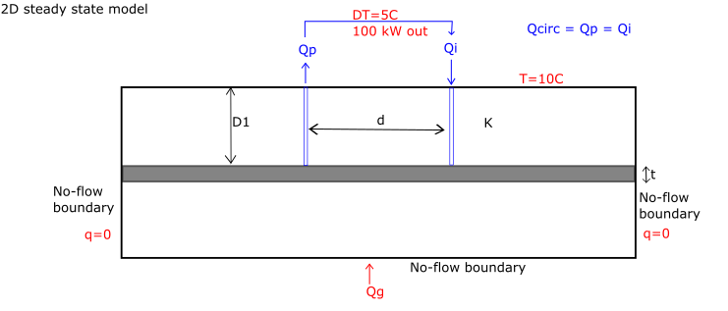
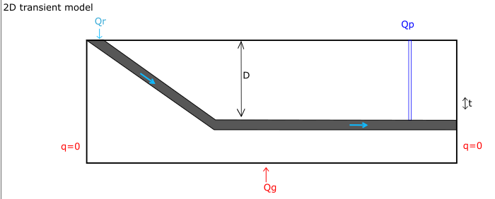
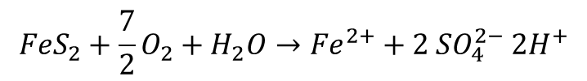
Objective 1
Introduction
Methods
Objectives
Conclusion
Summary
Potential source of heat
natural heat flow
local heat generation
solar influx
groundwater flow
geological structure
Conceptual models
Sensitivity analysis
Data inventory
Temperature
Water level
Geochemistry
Solar flux
Rainfall
$${FeS}_{2}+\frac{7}{2}O_{2}+H_{2}O→{Fe}^{2+}+2 {SO}_{4}^{2−} {2H}^{+}$$
Notes:
1) 1D model for linear temperature profiles (compare with existing EC-T logs) + 2D models based on conceptual/simple mine geometry
Local heat generation : radiactive decay, pyrite oxidation
Groundwater flow = convective flux
geological structure: geological formation with specific material, thermal and hydraulic properties; geological disturbances (i.e. faults)
2) Sensitivity analysis on geometrical, technical or numerical parameters: Simulation of cold water injection/recharge will allow determining, through sensitivity analysis, the parameters the more likely to influence mine water temperature.
3) Data inventory made
Mine temperature profiles/time-series will be compared to geological, climatic conditions in Scotland and in the UK

Slide 10
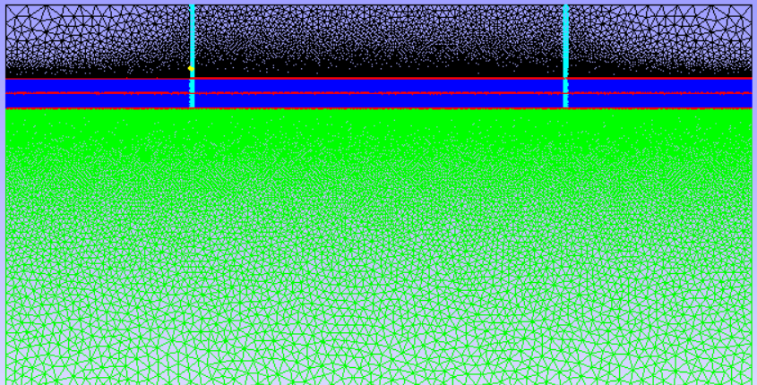
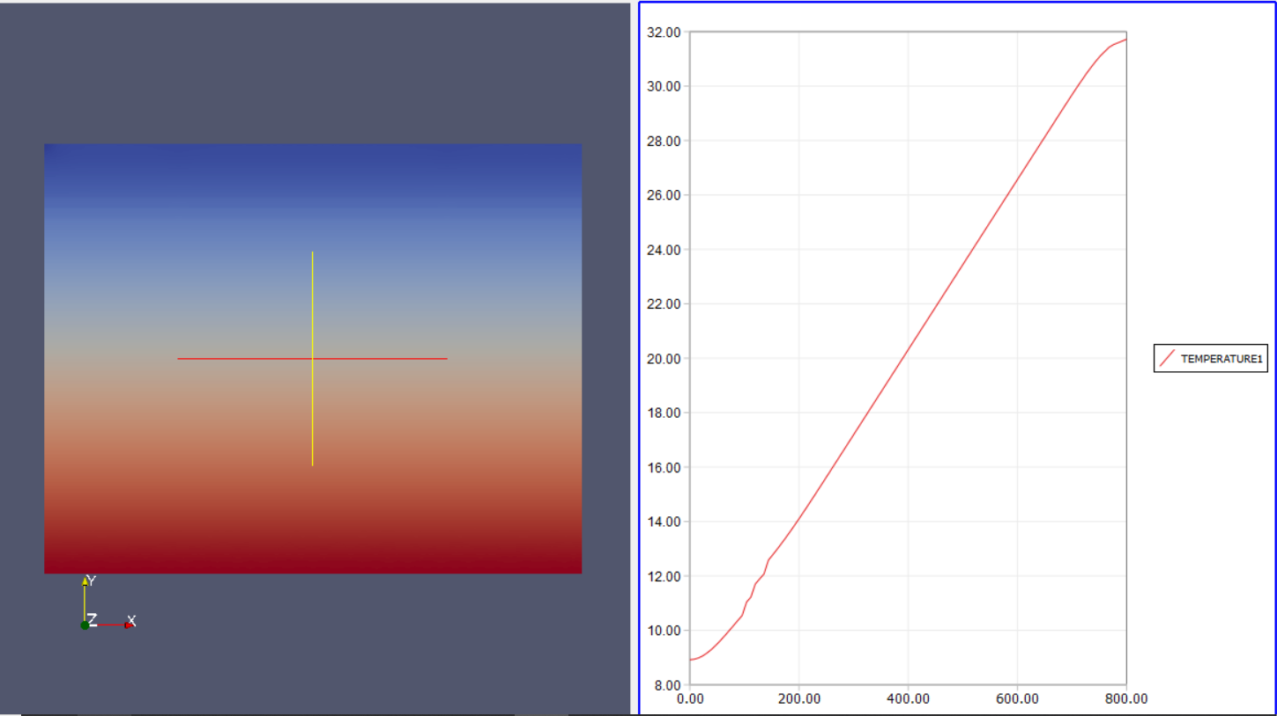
Objective 1
Introduction
Methods
Objectives
Conclusion
Summary
Numerical modelling using OpenGeosys
Notes:
OGS: open source FEM software
1) 1D model for linear temperature profiles (compare with existing EC-T logs) + 2D models based on conceptual/simple mine geometry
Local heat generation : radiactive decay, pyrite oxidation
Groundwater flow = convective flux
geological structure: geological formation with specific material, thermal and hydraulic properties; geological disturbances (i.e. faults)
2) Sensitivity analysis on geometrical, technical or numerical parameters: Simulation of cold water injection/recharge will allow determining, through sensitivity analysis, the parameters the more likely to influence mine water temperature.

Slide 11
Objective 2
Introduction
Methods
Objectives
Conclusion
Summary
Determine the main heat sources and heat transfer mechanisms in flooded coal mines
What is the heat recovery rate?
Assess the important geometrical features in mine plans.
How can representative simplification of mine plans be made?
Evaluate the footprint area of heat extraction
What is the geothermal potential of mines?
Can a sustainable heat extraction rate be maintained?
Notes:
Mine plans are complex. A certain level of simplification is necessary. To what extent can we simplify it and what features are really important?

Slide 12
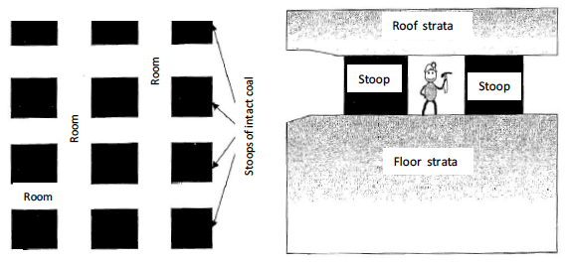
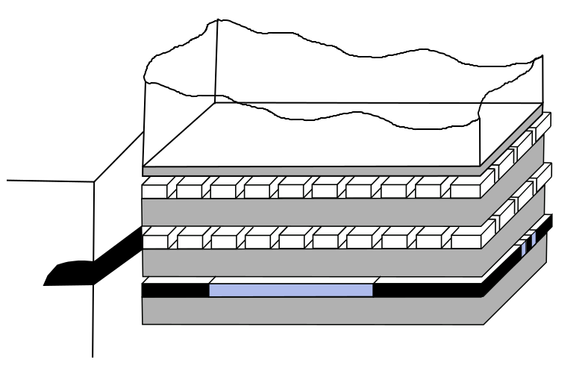
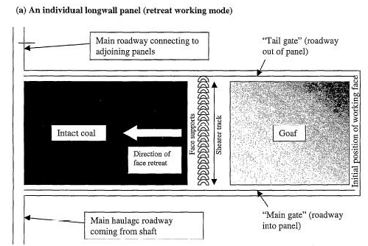
Introduction
Methods
Objectives
Conclusion
Summary
Underground workings:
Pillar and stall
Longwall mining
Main pathways :
Shafts
Roadways
Objective 2
Layout of stoop and room mine workings (top) and longwall mining (bottom). From Younger and Adams, 1999.

Slide 13
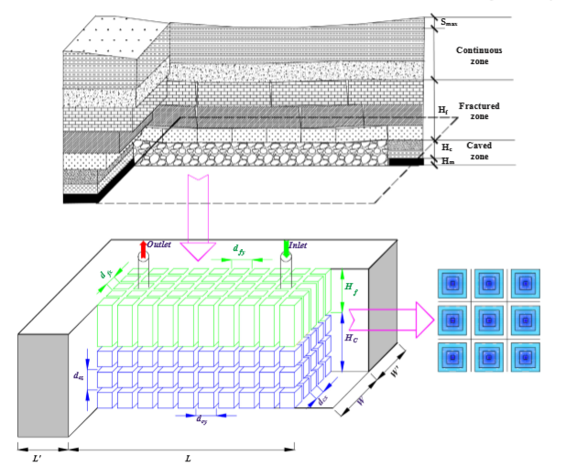
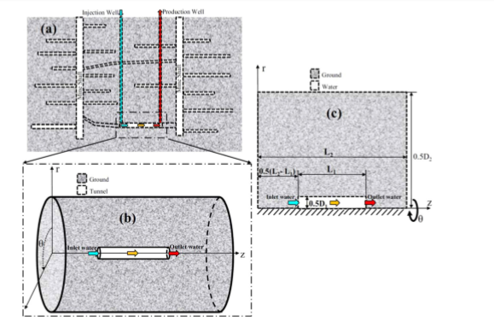
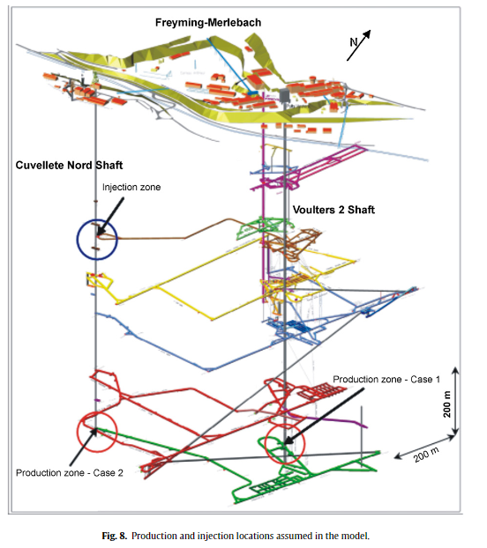
Introduction
Methods
Objectives
Conclusion
Summary
Modeling approches in the literature
Objective 2
Dual-porosity medium (Guo at al., 2018)
Heat transfer in mine tunnels
Ghoreishi Madeish et al. (2012)
3D model of shaft/roadway connections
(Hamm et al., 2010)
Combined 3D porous medium and 1D pipe flow
(Raymond and Therrien, 2008; Renze et al., 2009)
Notes:
Modeling: difficulty to solve for heat/mass transfers in porous medium and pipes.

Slide 14
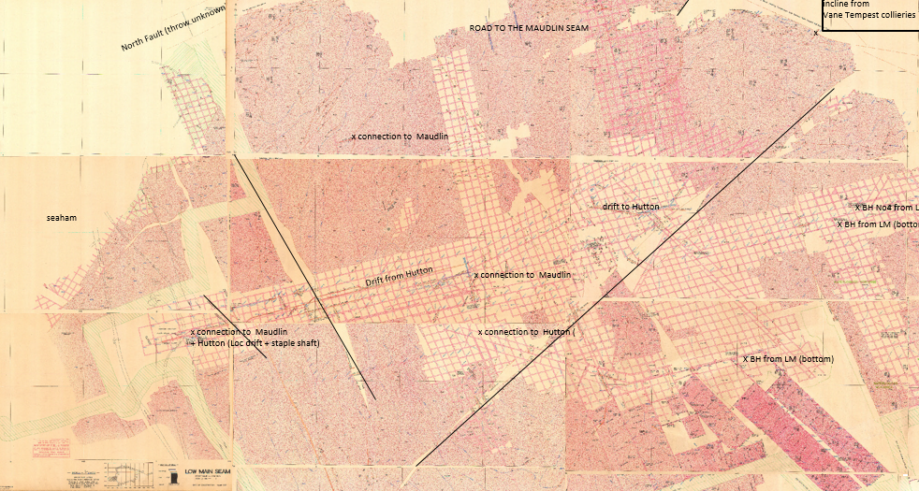
Introduction
Methods
Objectives
Conclusion
Summary
Mine plans, in reality:
Mine archives
Rationalized / Digitalized versions
How can we simplify it to build representative models, using digitalized data ?
Objective 2
Notes:
Difficulty in mine systems (which differs from usual aquifers) is the necessity to solve for water, heat and mass transport in a system composed of a porous media (Darcy flow) and open void (pipe flow) that can lead to numerical instability.

Slide 15
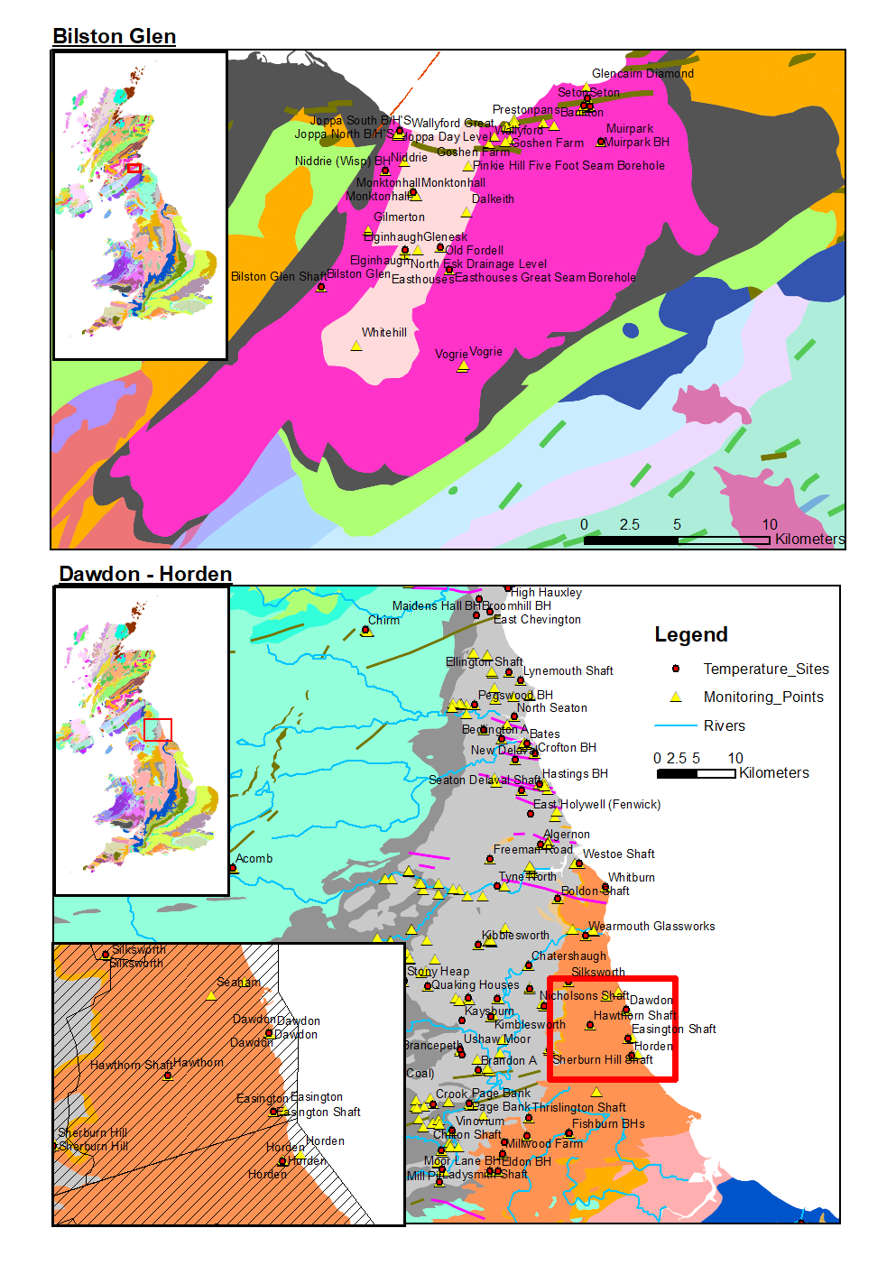
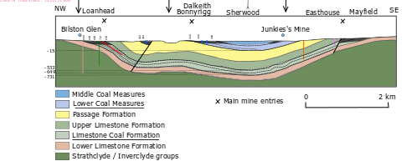
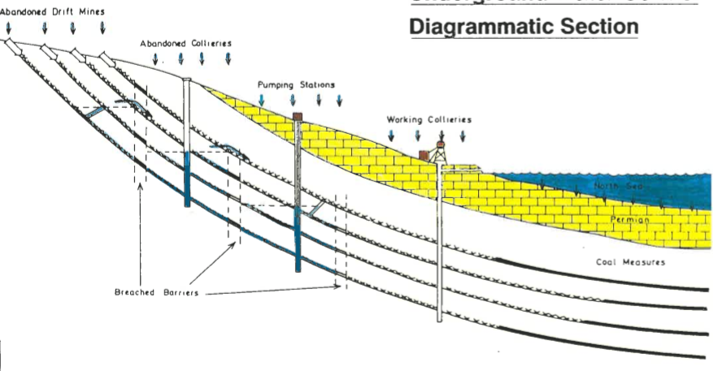
Introduction
Methods
Objectives
Conclusion
Summary
2 Case study : Dawdon area (NE England) and Bilston Glen (Scotland)
Notes:
The research will involve numerical modelling of mines, calibrated and validated using real data from 2 different areas:
Bilston Glen in Scotland
Dawdon in NE England
→ Enough data to calibrate the models and different geometries

Slide 16
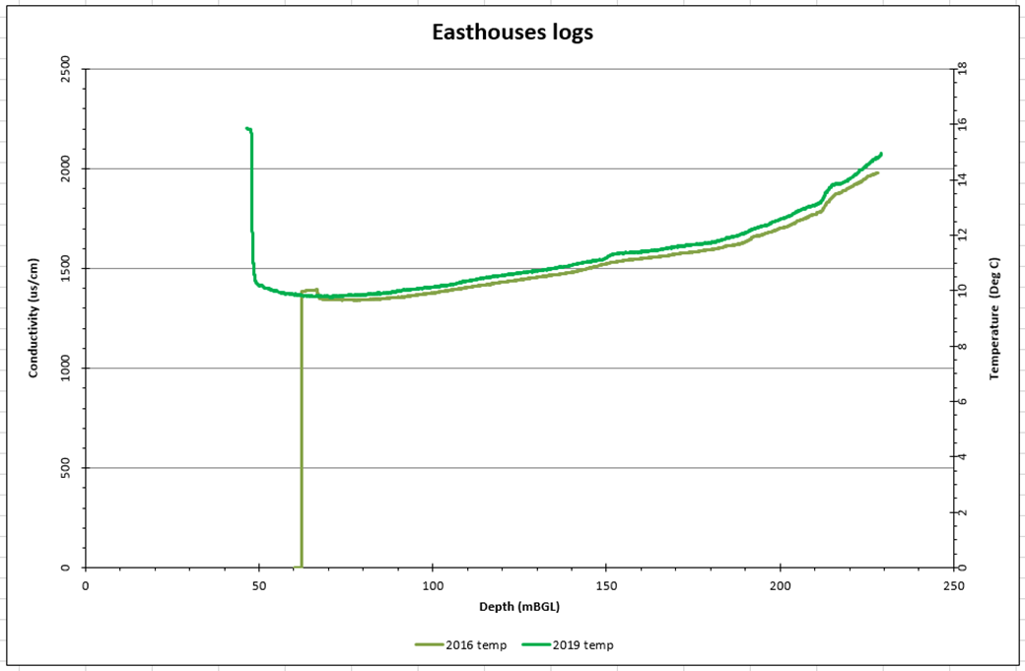
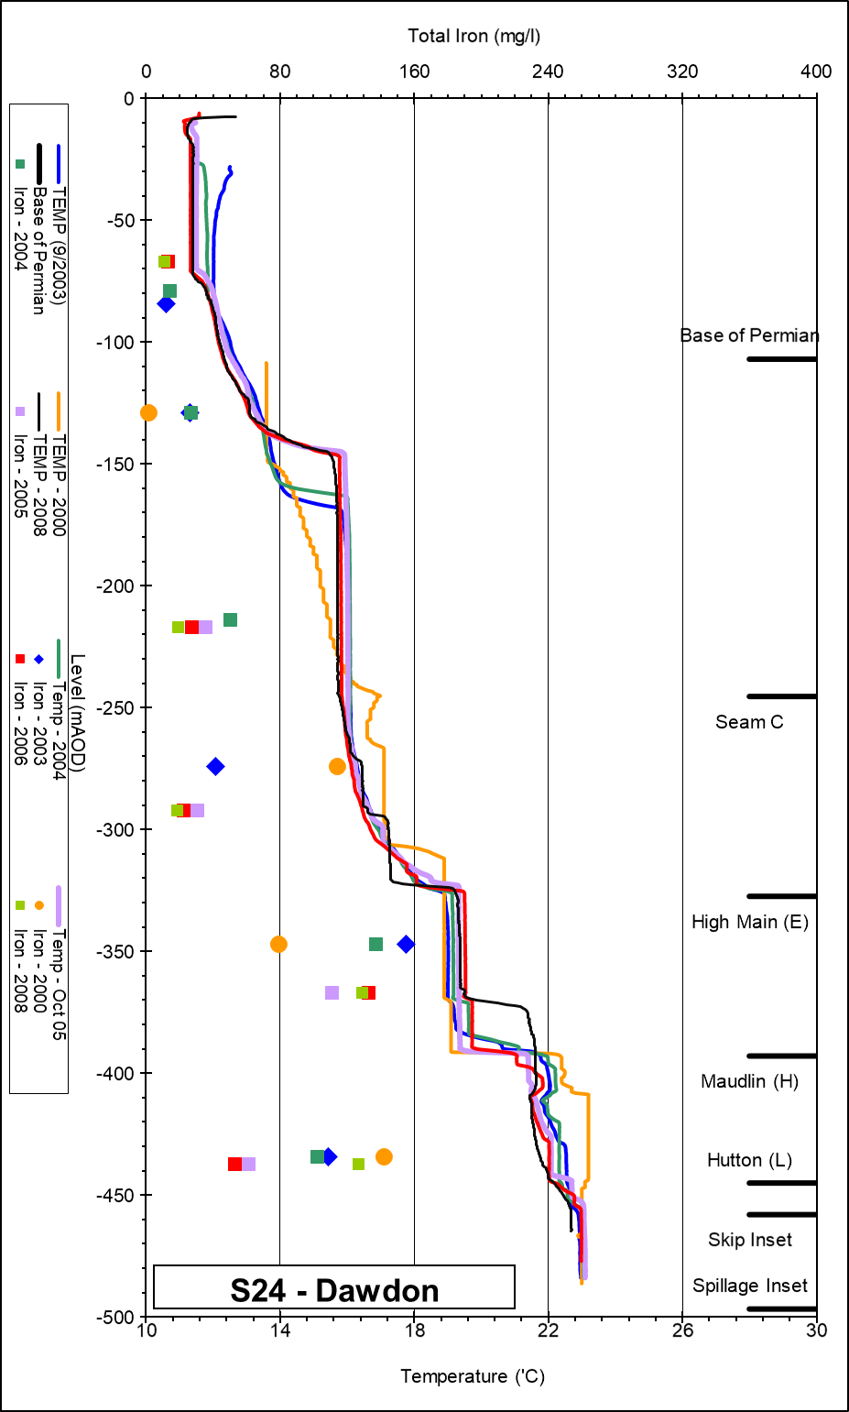
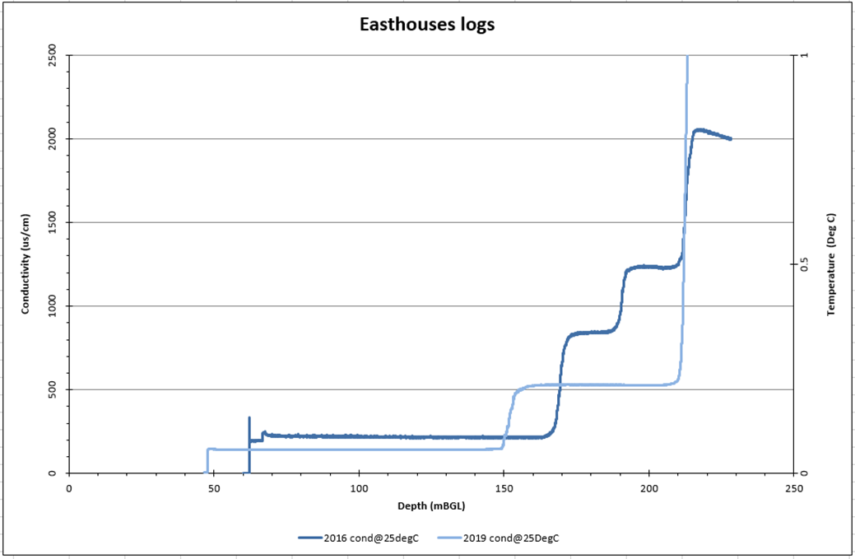
Introduction
Methods
Objectives
Conclusion
Summary
2D Horizontal models
Heat transfer in different type of underground workings
2D Vertical models
Model calibration using available data:
Water level
Flow rate
Temperature
Reproduce temperature-EC profiles / water level
Development of a methodology to build representative statistical distribution of mine voids
Conclusion on the important features to consider
Objective 2
Notes:
A series of model will be created through the development of a methodology to generate a representative statistical distribution of mine working network / roadways. Calibration and validation of model using existing data (i.e. simulation of flooding, flow rate, temperature profile).
Water level = logger and on site measurements
Temperature: Logger temperature and on-site measurements (Temperature versus time)
+ Temperature and conductivity logs
Geochemistry: Deep water in Dawdon (Chloride anion dominant = long residence time) while shallow water in Bilston Glen (Bicarbonate dominant) according to Chebotarev chart
Issue with loggers: no information about the depth of the sensor, but can inform on seasonal changes in temperature

Slide 17
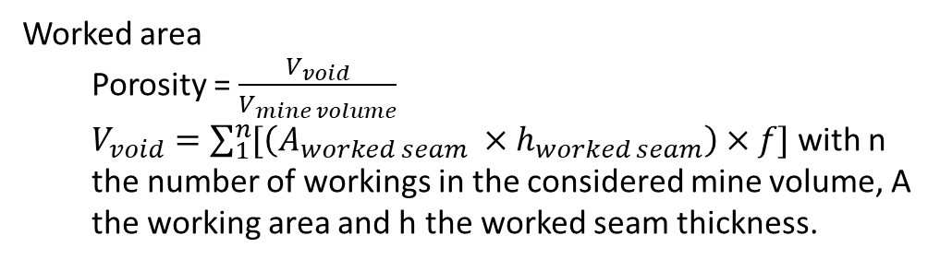
Introduction
Methods
Objectives
Conclusion
Summary
Bilston Glen shaft
Victoria and
Dicken’s shafts
Junkie’s
Bryan’s
Easthouse
incline/shaft
Discharge zones
Emily’s shaft
Roslin
Shallow workings (Whithill, Polton, Glenesk, Eldindean, Dalhousie, Alkaiden…)
Ramsay
?
Burghlee
?
Newbattle
Bilston Glen
?
Newton Grange
Arniston
Objective 2
Lingerwood/Easthouse
Lady Victoria/
Lingerwood
Worked area
Porosity = $\frac{V_{void}}{V_{mine volume}}$
$V_{void}=\sum_{1}^{n}{[\left(A_{worked seam} ×h_{worked seam}\right)}×f]$ with n the number of workings in the considered mine volume, A the working area and h the worked seam thickness.
Notes:
A series of model will be created through the development of a methodology to generate a representative statistical distribution of mine working network / roadways. Calibration and validation of model using existing data (i.e. simulation of flooding, flow rate, temperature profile).
Water level = logger and on site measurements
Temperature: Logger temperature and on-site measurements (Temperature versus time)
+ Temperature and conductivity logs
Geochemistry: Deep water in Dawdon (Chloride anion dominant = long residence time) while shallow water in Bilston Glen (Bicarbonate dominant) according to Chebotarev chart
Issue with loggers: no information about the depth of the sensor, but can inform on seasonal changes in temperature

Slide 18
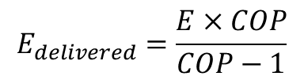
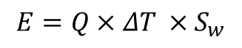
Objective 3
Introduction
Methods
Objectives
Conclusion
Summary
Determine the main heat sources and heat transfer mechanisms in flooded coal mines
What is the heat recovery rate?
Assess the important geometrical features in mine plans.
How can representative simplification of mine plans be made?
Evaluate the footprint area of heat extraction
What is the geothermal potential of mines?
Can a sustainable heat extraction rate be maintained?
$$E=Q×ΔT ×S_{w}$$
$$E_{delivered}=\frac{E×COP}{COP−1}$$

Slide 19
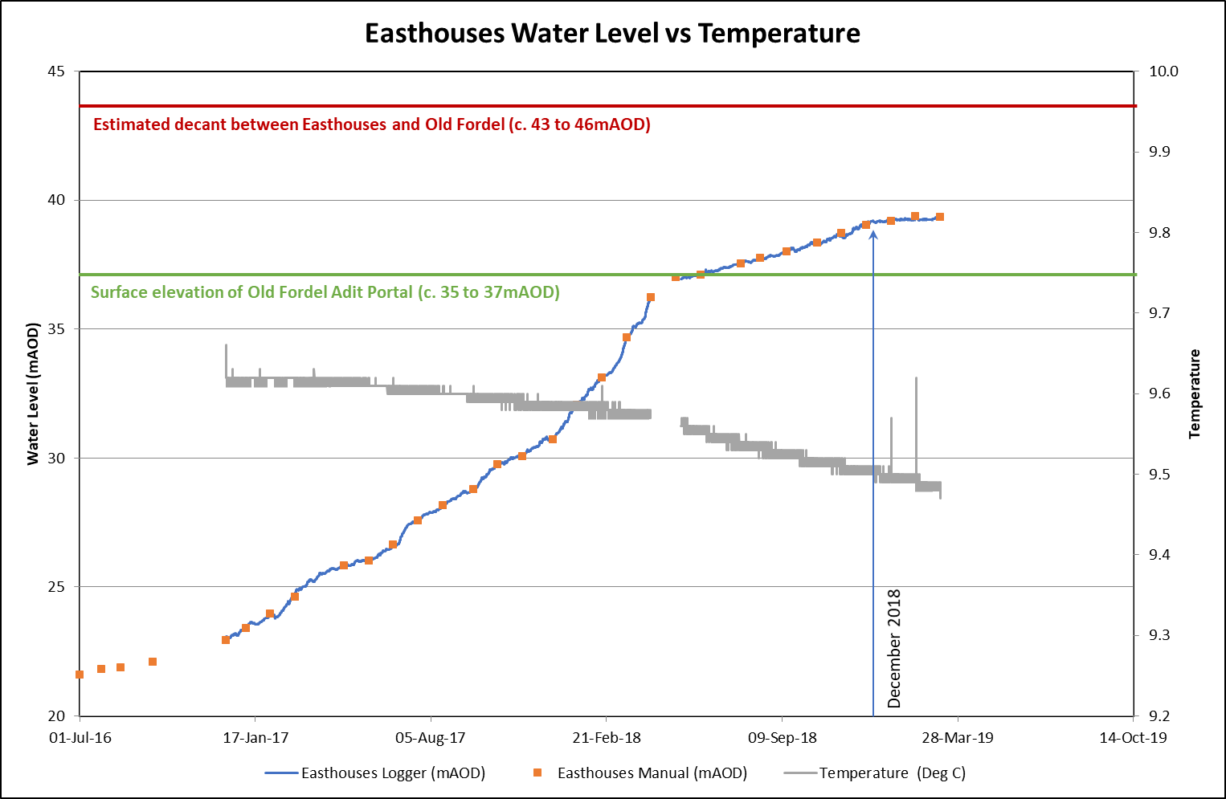
Introduction
Methods
Objectives
Conclusion
Summary
Based on 2D / 3D models of Bilston Glen / Dawdon
Validation with data acquired through the phD time
Temperature profile
Water level, flow rate and temperature time series
Objective 3
Notes:
Based on calibrated model, evaluation of the recharge rate / heat recovery rate of mine water. How long can it be sustained? what is the footprint area for providing heat for domestic heating?

Slide 20
Introduction
Methods
Objectives
Conclusion
Summary
Development of a predictive (conceptual or numerical) tool.
Recommendation on a scientific approach to guide the licensing of heat
Support the dimensioning of GSHP systems

Slide 21
References
Gillespie, M., Crane, E., and Barron, H. (2013). Study into the Potential for Deep Geothermal Energy in Scotland - Volume 2. AEC/001/11. Scottish Government, p. 129.
Todd, F., McDermott, C., Harris, A. F., Bond, A., and Gilfillan, S. (2019). Coupled hydraulic and mechanical model of surface uplift due to mine water rebound: implications for mine water heating and cooling schemes. Scottish Journal of Geology [online], sjg2018–028. ISSN: 0036-9276, 2041-4951. DOI: 10.1144/sjg2018-028.

